Slide 1
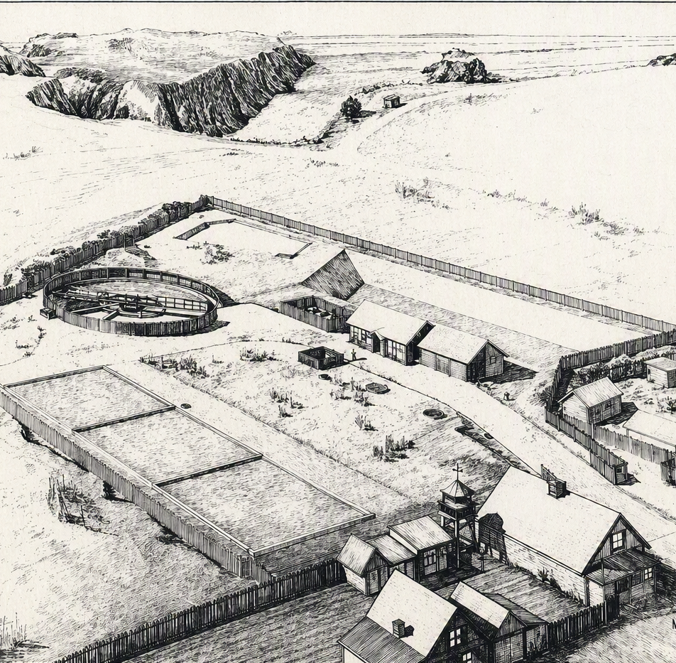

Mendocino, CA
Alternative Analysis
September 25th, 2026

Slide 2
AGENDA
01
NEED FOR THE PROJECT
02
ALTERNATIVE 1: Rehabilitation and Operational Continuity Approach
03
ALTERNATIVE 2: Rehabilitation and Optimized Modern Configuration
04
ALTERNATIVE 3: Rehabilitation and High-Quality Effluent for Reuse
05
COST COMPARISON AND MULTI-CRITERIA EVALUATION
06
NEXT STEPS

Slide 3
Need for the Project
1

Slide 4
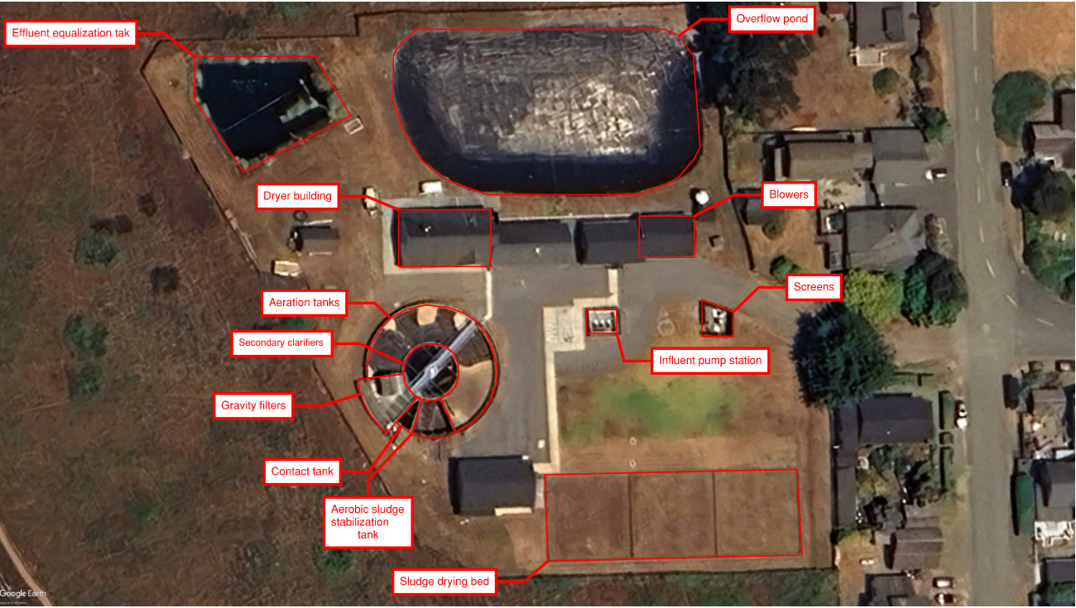
Overview of the MCCSD Wastewater Treatment Facility

Slide 5
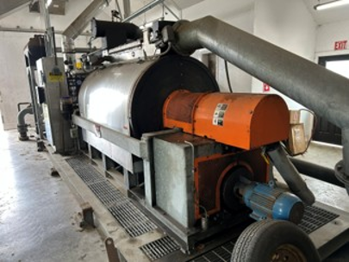
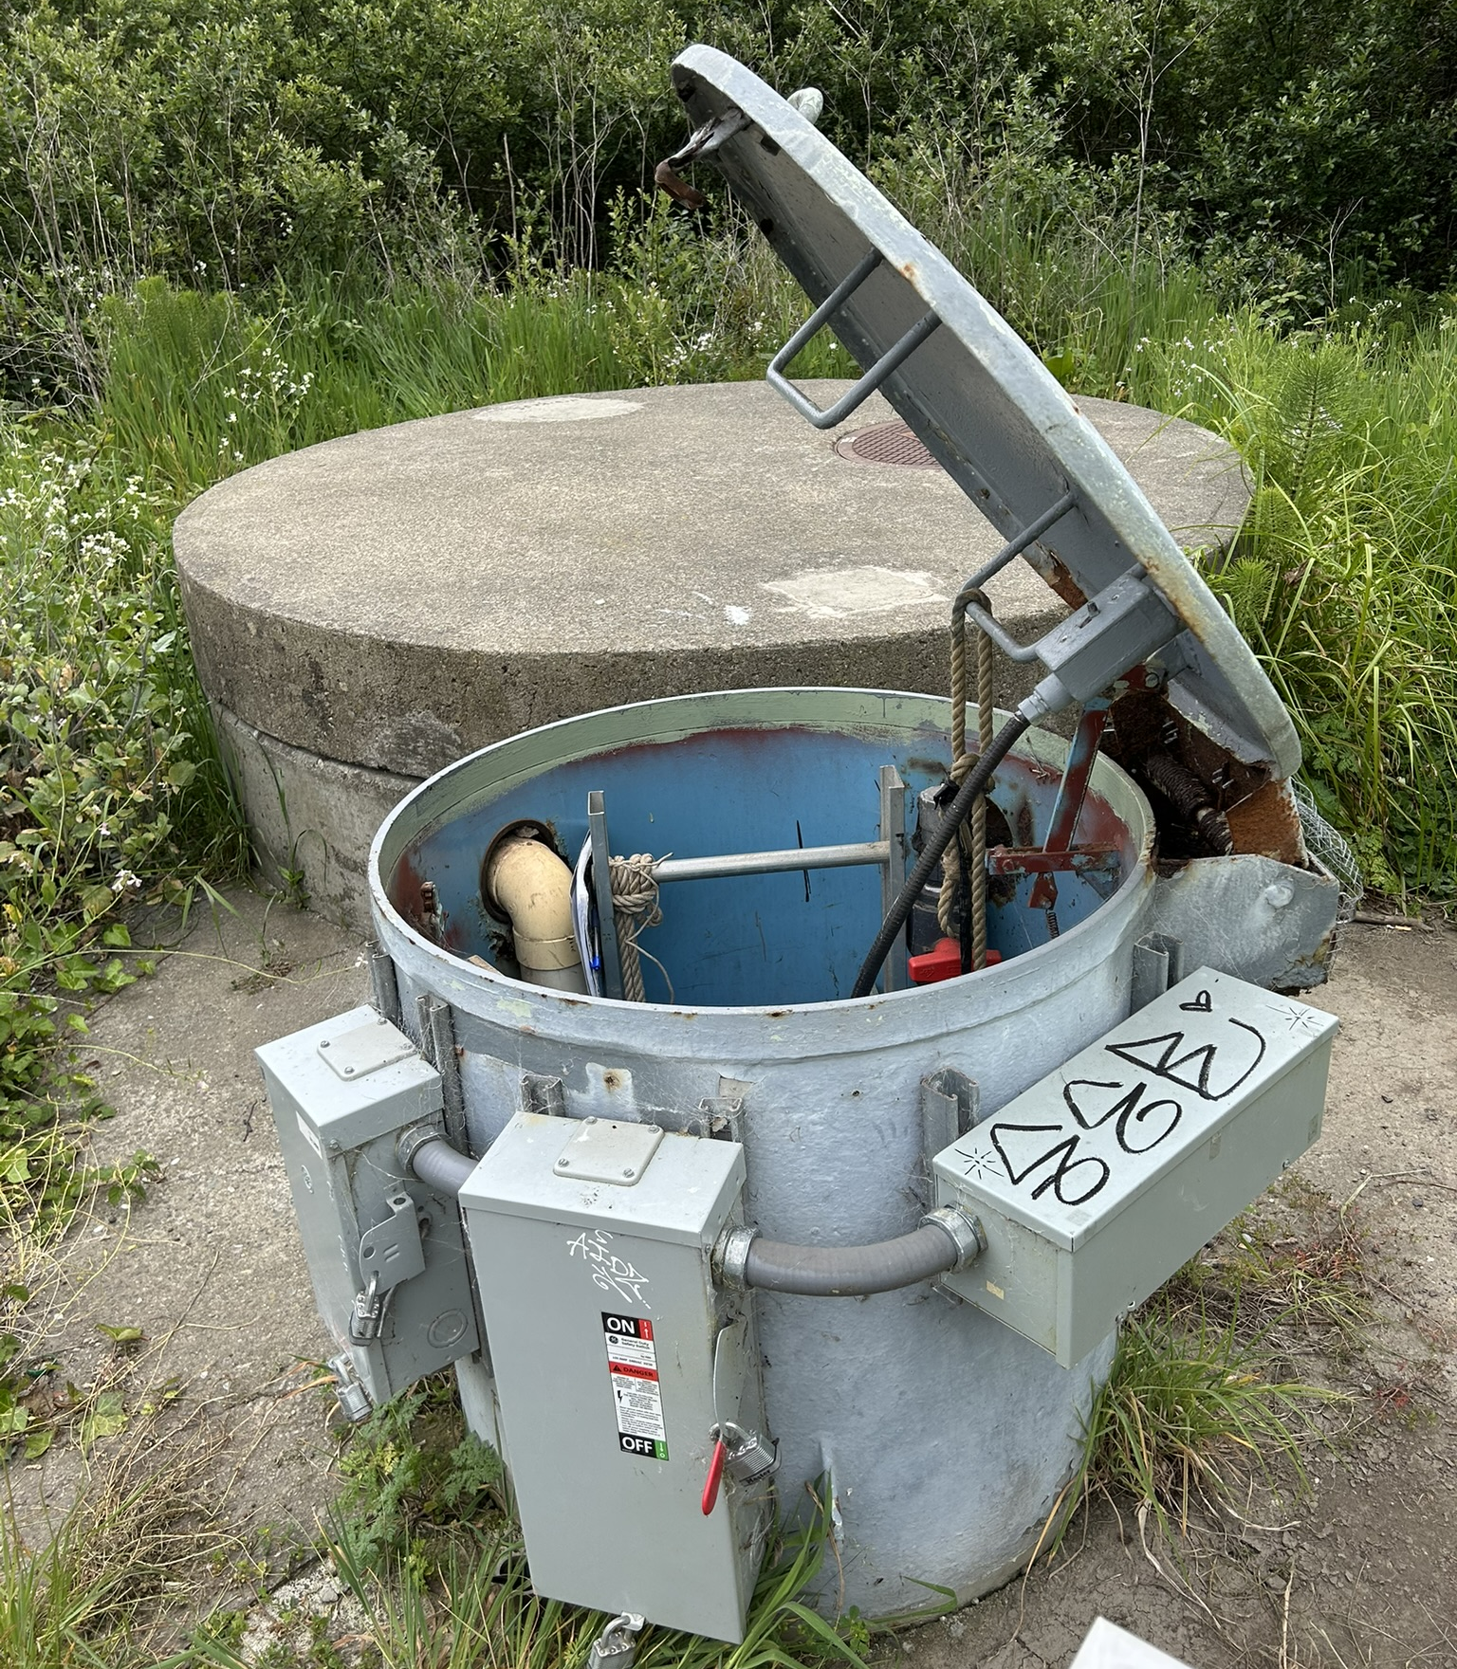
Need for the Project
Aging treatment and collection system infrastructure
Limited redundancy creates operational risk
Critical equipment nearing end of service life
Lift station safety and maintenance concerns
Wet weather flow management challenges
Future regulatory and recycled water requirements

Slide 6
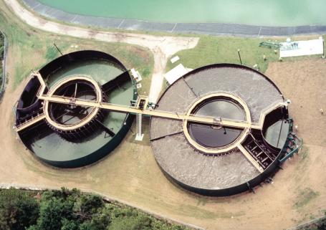
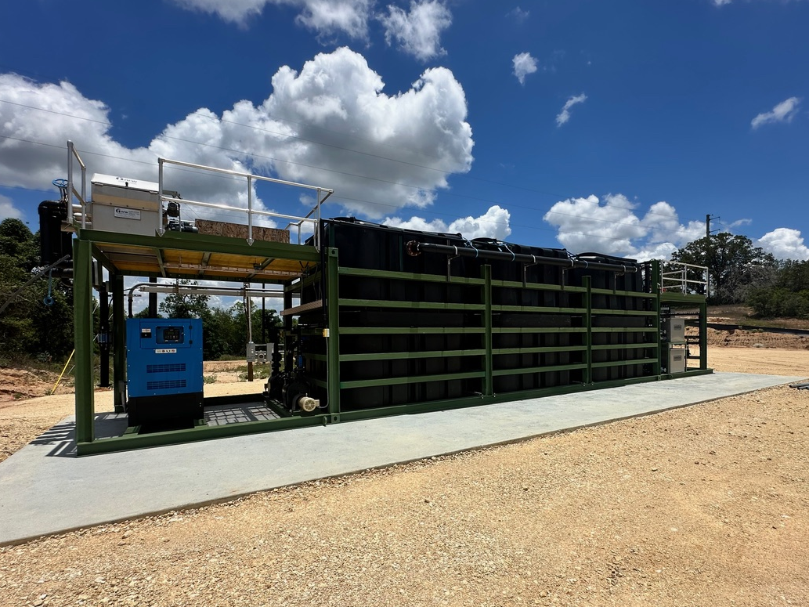
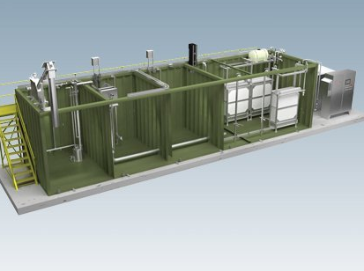
Overview of Alternatives
Alternative
Alternative
Alternative
Rehabilitation and Operational Continuity Approach​
Rehabilitation and Optimized Modern Configuration
Rehabilitation and High-Quality Effluent for Reuse

Slide 7
Project Objectives
Increase treatment process redundancy
Replace aging infrastructure and equipment
Enhance operator safety
Improve wet weather flow management
Support future water reuse and regulatory requirements

Slide 8
Alternative 1:
Rehabilitation of Existing Package Plant and Operational Continuity Approach
02

Slide 9
Alternative 1 Description
Rehabilitate the existing treatment facilities and add a second package treatment train.
Increase process redundancy and operational reliability.
Expand overflow storage capacity to improve wet weather resiliency.
Maintain familiar treatment processes and operations for staff.
Allow phased implementation while maintaining plant operations.

Slide 10
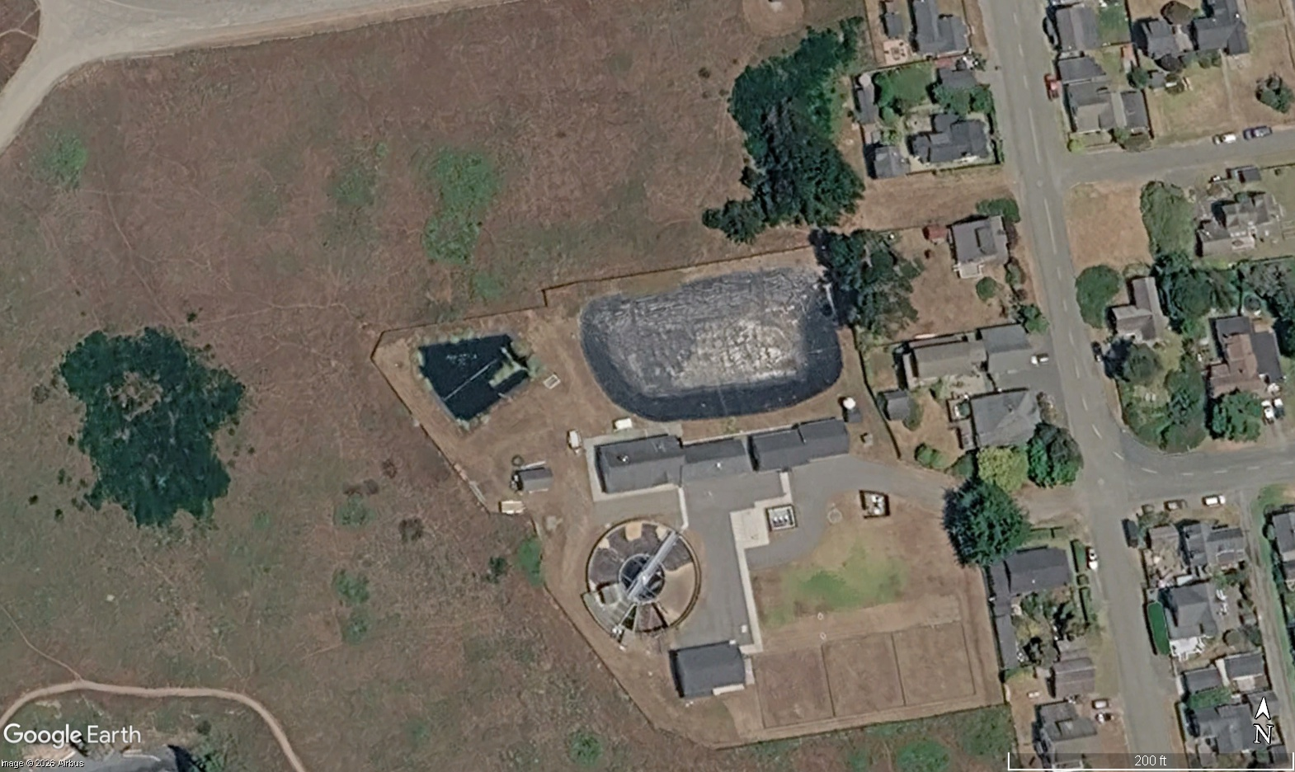
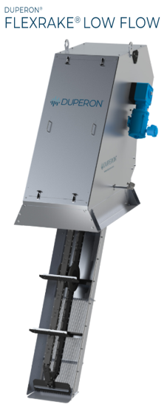

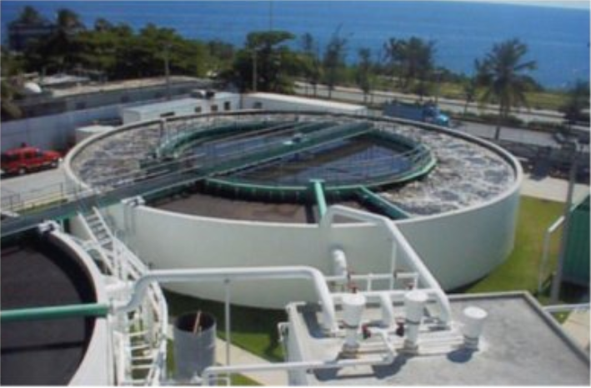

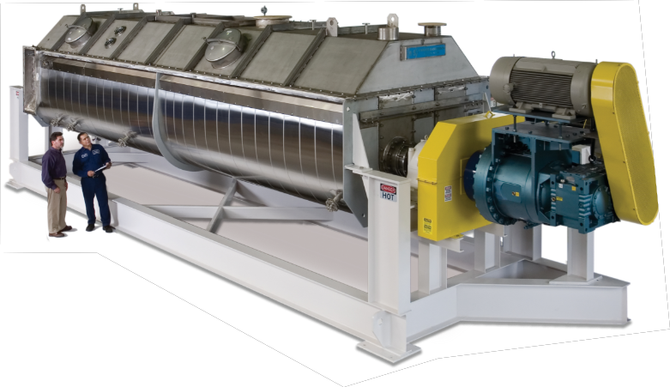
Alternative 1: Rehab and Operational Continuity - Layout
LEGEND OF IMPROVEMENTS
  Lift station upgrades (not shown)
  New overflow pond
  New screening
  New concentric package plant
  New solids dryer
1
0
1
2
3
4
3
4
2

Slide 11
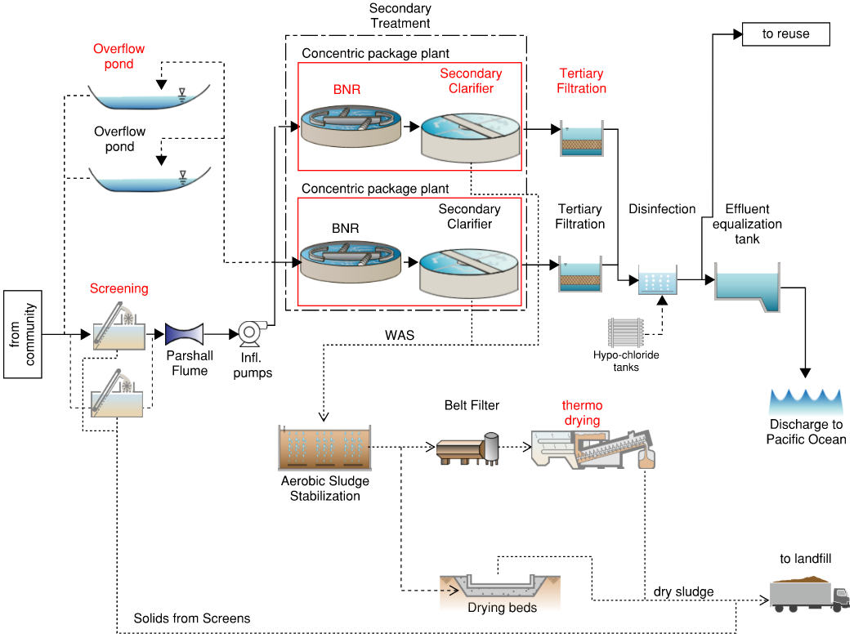
Alternative 1: Rehab and Operational Continuity

Slide 12
Alternative 2:
Rehabilitation of Existing Package Plant and Optimized Modern Configuration
03

Slide 13
Alternative 2 Description
Rehabilitate the existing facilities and add a new treatment train using a different treatment technology.
Increase system reliability through process diversification.
Improve operational flexibility and reduce dependence on a single treatment process.
Evaluate upgrades to solids handling facilities, including sludge dryer and digester.
Enhance long-term maintainability and resilience.

Slide 14
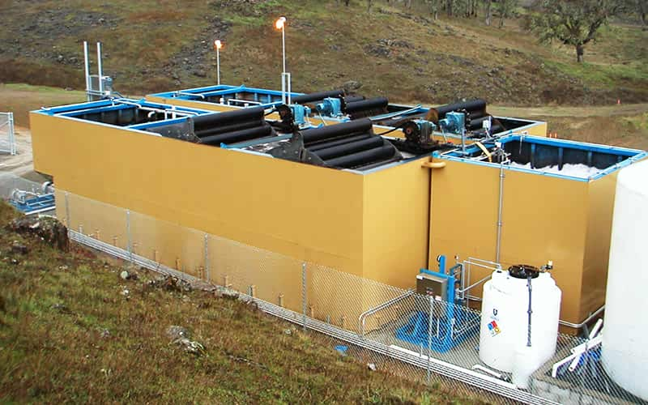

Alternative 2: Rehab and Optimized Modern Configuration - Layout
LEGEND OF IMPROVEMENTS
  Lift station upgrades (not shown)
  New overflow pond
  New screening
  New BNR package plant
  New solids dryer
1
0
1
2
3
4
3
4
2

Slide 15
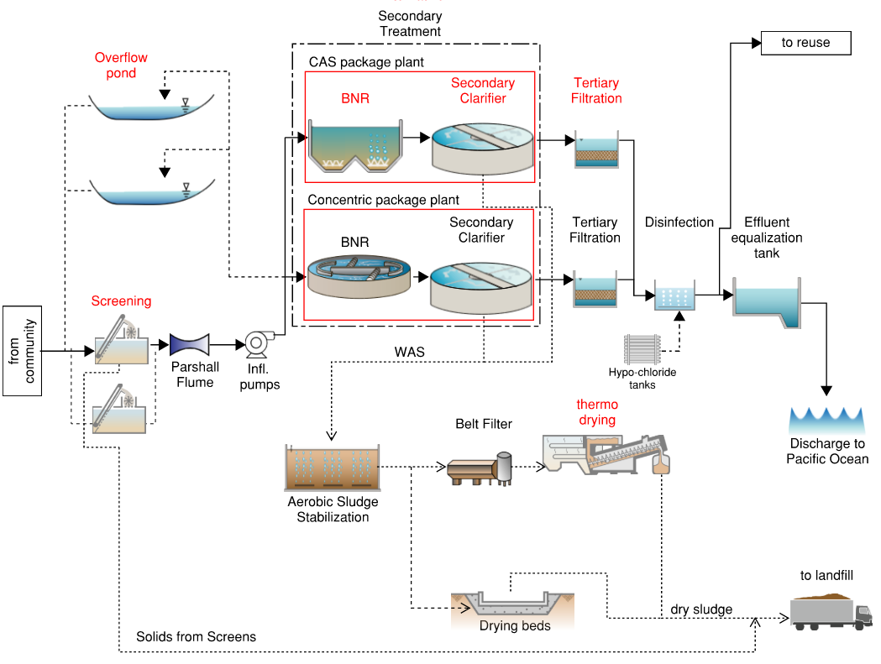
Alternative 2: Rehabilitation of Existing Package Plant and Optimized Modern Configuration

Slide 16
Alternative 3:
Rehabilitation of Existing Package Plant and High-Quality Effluent for Reuse
04

Slide 17
Alternative 3 Description
Rehabilitate the existing facilities and construct a new advanced treatment system.
Provide the highest level of treatment performance and reliability.
Support future recycled water reuse opportunities and Title 22 compliance objectives.
Improve nutrient removal capabilities and effluent quality.
Position the District for long-term regulatory and community needs.

Slide 18
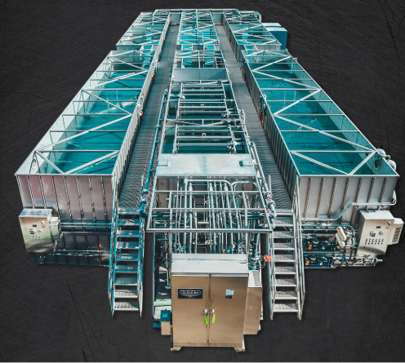
Alternative 3: Rehab and High-Quality Effluent for Reuse - Layout
LEGEND OF IMPROVEMENTS
  Lift station upgrades (not shown)
  New overflow pond
  New screening
  New MBR package plant
  New solids dryer
1
0
1
2
3
4
3
4
2

Slide 19
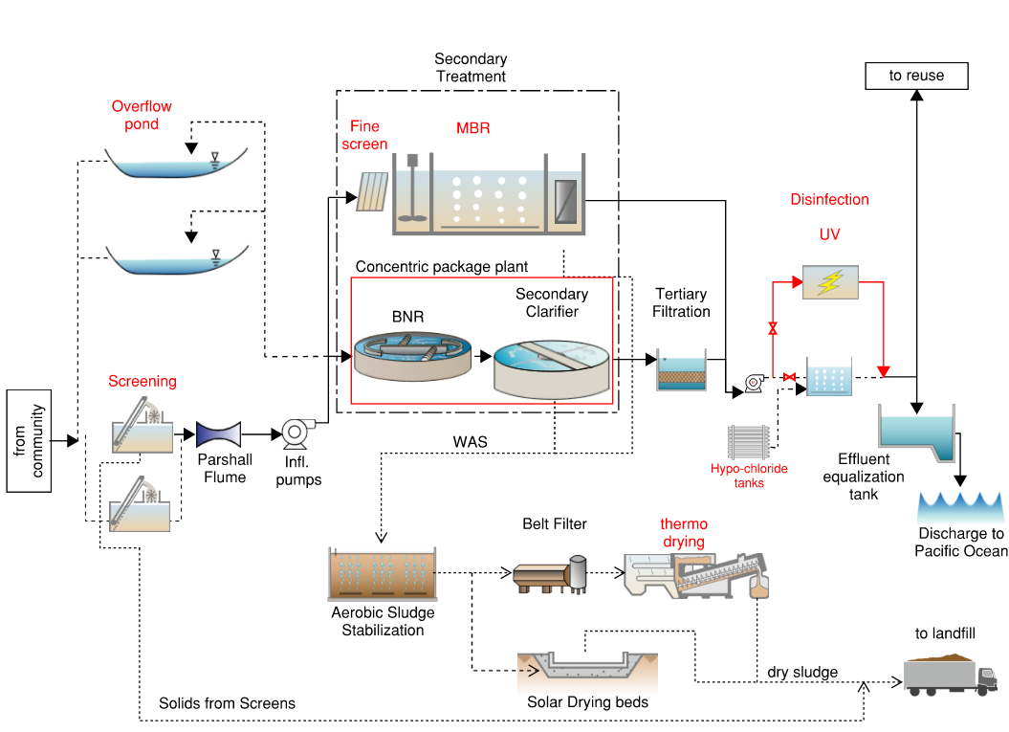
Alternative 3: Rehab and High-Quality Effluent for Reuse (Updated PFD)

Slide 20
Cost Comparison and Multi-Criteria Evaluation
05

Slide 21
Cost Estimating Assumptions – O&M Costs
O&M costs include:
  Admin Expenses
    Repair / Maintenance
    O&M (Annual repairs & maintenance; Supplies Tools & Services, Other Operating Expenses, Biosolids disposal)
    Insurance
  Energy
  Staff
    Admin wages (includes benefits)
    Operator wages
    Training and education
  Other O&M
    Chemical Cost - coagulant
    Chemical Cost - chlorine
    Chemical Cost - dechlorination
    Chemical Cost - Lime
    Chemical Cost - MBR cleaning
    Biosolids - dryer fuel
    Biosolids disposal
Annual escalation rates of:
  Construction escalation rate 6.0%
  Electricity escalation rate 2.0%
  Fuel escalation rate 2.0%
  Salary escalation rate 1.7%
  Admin Expense and O&M escalation rate 2.0%
Discount rate of 2.2%
Taxes, Construction Allowances
  E&IC Allowance 15%
  Taxes 7.875%
  Construction Contingency 35%
  Equipment Installation 30%
  General Conditions, Contractor Markups General Conditions Allowance 10%
  GC Overhead, Profit, Bonds, Mob 20%
Engineering & Administrative Costs 20%

Slide 22
Cost Estimating Assumptions – O&M Costs
 | Parameter Name | Value | Units
Admin Expenses | Laboratory analysis | $21,200 | $/year
 | Repair / Maintenance | $19,000 | $/year
 | O&M (Annual repairs & maintenance; Supplies Tools & Services, Other Operating Expenses, Biosolids disposal) | $81,000 | $/year
 | Insurance | $15,000 | $/year
 | Sum of Admin Expenses | $121,200 | $/year
Energy | Alt 1: No Action | $ 98,000 | $/year
 | Alt 2: Rehabilitation and Operational Continuity Approach​​ | $ 98,000 | $/year
 | Alt 3: Rehabilitation and Optimized Modern Configuration​ | $ 98,000 | $/year
 | Alt 4: Rehabilitation and High-Quality Effluent for Reuse​ | $ 156,900 | $/year
 | Alt 5: |  | $/year
Staff | Admin wages (includes benefits) | $ 171,900 | $/year
 | Operator wages | $ 99,400 | $/year
 | Training and education | $ 1,000 | $/year
 | Sum of Staff Expenses (Salaries, benefits and training) | $ 272,300 | $/year
Other O&M | Chemical Cost - coagulant | $2,300 | $/year
 | Chemical Cost - chlorine | $28,100 | $/year
 | Chemical Cost - dechlorination | $7,800 | $/year
 | Chemical Cost - Lime | $3,100 | $/year
 | Chemical Cost - MBR cleaning | $2,000 | $/year
 | Biosolids - dryer fuel | $25,000 | $/year
 | Biosolids disposal | $33,500 | $/year

Slide 23
Comparison of Life Cycle Costs

Slide 24
Evaluation Criteria
Assumed: All alternatives provide adequate capacity and treatment for current and future conditions and meet regulatory requirements in the discharge permit.
Criteria | Description | Weight
Footprint | Fits on existing site. Minimizes area. | 25%
Robustness | Treats variable influent flows and loads. | 10%
Constructability | Easy to construct with minimal disruption to existing plant operations. | 25%
O&M Complexity | Minimizes required operator hours and certifications. | 20%
Effluent Quality | Compatibility with reuse application | 20%
TOTAL WEIGHT |  | 100%

Slide 25
Evaluation Criteria
Alternatives are ranked on each criterion from 1 (worst) to 3 (best), as shown in the table.
Rankings are weighted and summed to calculate a total weighted score.
The highest total weighted score is the most favorable.
Criteria | Weight | Alternative 1 | Alternative 2 | Alternative 3
Footprint | 25% | 2 | 2 | 3
Robustness | 10% | 2 | 3 | 3
Constructability | 25% | 2 | 2 | 2
O&M Complexity | 20% | 3 | 2 | 1
Effluent Quality | 20% | 1 | 2 | 3
TOTAL WEIGHTED SCORE |  | 2.0 | 2.2 | 2.4

Slide 26
Next Steps
06

Slide 27
Thank you!
Next Steps
Oct 30 - Proposed Alternative and Recommendations (Section 6 and 7)
Nov 27 - Draft PER submittal
Dec 21 - Final PER
Anna Malakian
Sam Reifsnyder
Bernardo Castro
Allie McCurdy

Slide 28
Supporting Slides
S

Slide 29
Overflow Pond Sizing
S1

Slide 30
Design Criteria
Design Parameter | Unit | 2026 | 2046 | Design Basis
Population, Connected to Sewer | People | 966 | 1,166 | Assumed the annexation of Surfwood Homes Community to the MCCSD sewer system (~200ppl)
Average Dry Weather Flow (ADWF) | gpd | 66,761 | 80,583 | 69 gpcd x Population. 69 gpcd is based on current dry weather flow and population data
Peak Dry Weather Flow (PDWF) | gpd | 106,333 | 128,349 | Current PDWF based on historical data (2023-2025). Future PDWF = Population x ADF per capita flow x PDWF/ADF peaking factor (x1.6).
Annual Average Flow (AAF) | gpd | 99,051 | 119,559 | Current AAF based on historical data (2023-2025) with AAF/ADWF peaking factor (x1.5). Future AAF = AAF₍₂₀₂₆₎+ (ADWF₍₂₀₄₆₎-ADWF₍₂₀₂₆₎).
Max Month Flow | gpd | 208,667 | 251,870 | Current MMF based on historical data (2023-2025) with MMF/ADWF peaking factor (x3.1). Future MMF = MMF₍₂₀₂₆₎+ (ADWF₍₂₀₄₆₎-ADWF₍₂₀₂₆₎).
Peak Wet Weather Flow (PWWF) | gpd | 404,000 | 487,644 | Current PWWF based on historical data (2023-2025) with PWWF/ADWF peaking factor (x6.1). Future PWWF = PWWF₍₂₀₂₆₎+ (ADWF₍₂₀₄₆₎-ADWF₍₂₀₂₆₎).
BOD Average Dry Weather Load (ADWL) | ppd | 235 | 284 | Based on historical dry weather data from 2023-2025.
TSS Average Dry Weather Load (ADWL) | ppd | 203 | 245 | Based on historical dry weather data from 2023-2025.
Source: #9 Flow Data -> Coli10percent
Notes:
Overflow pond size based on peak day wet weather flows (PWWF)

Slide 31
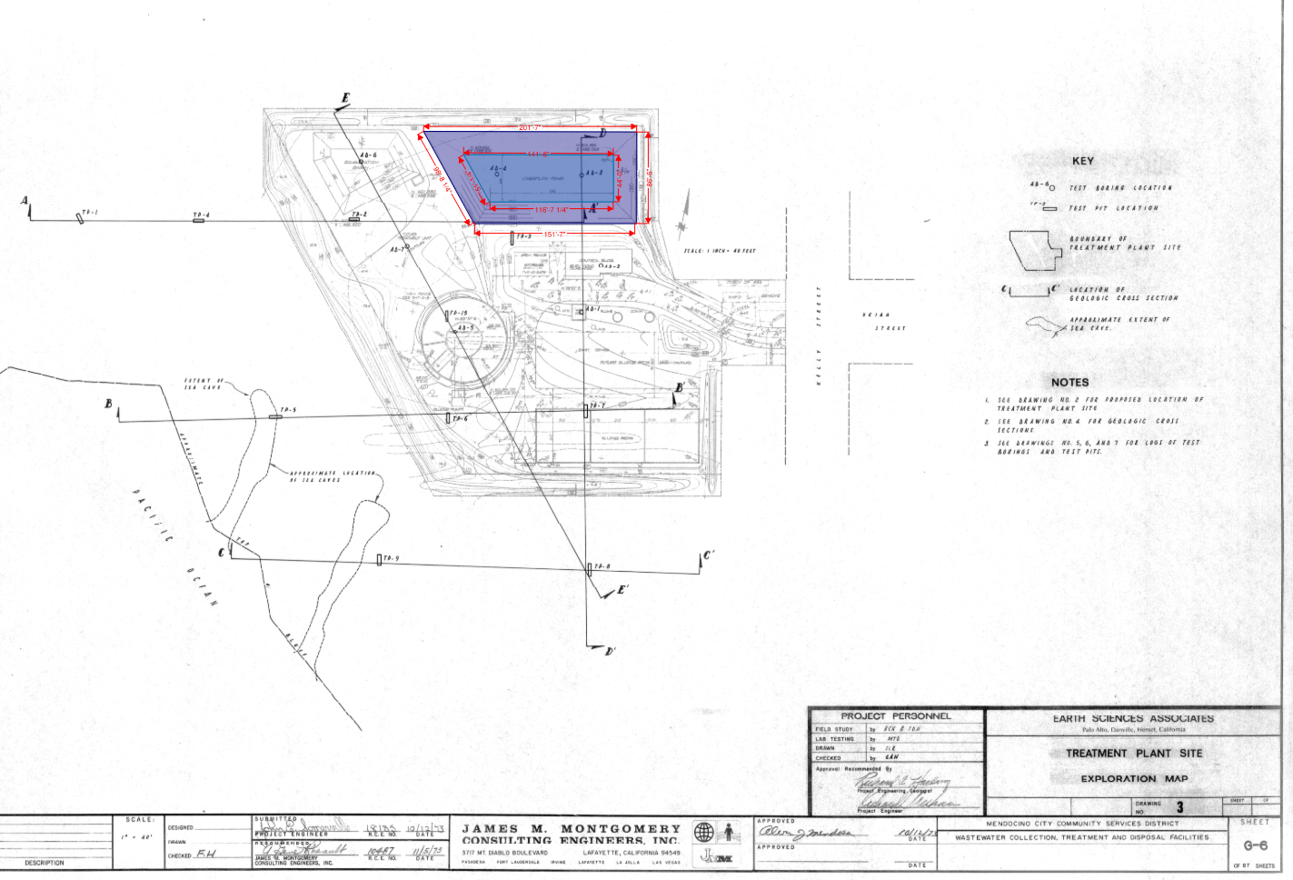
Overflow Pond Sizing - Assumptions
Assumptions for calculation:
The bottom shape is geometrically similar to the top shape.
The offsets occur equally on both sides of each dimension.
Depth of pond in all area is 11 ft
H.W.L is 6 ft in all area
Pond Volume (Gal) | ~831,820
Capacity of pond (Gal) | ~356,000
Source: #2 Drawings, WWTP -> Original MCCSD Treatment Plants Plans -> G-6

Slide 32
Overflow Pond Sizing- Scale Factor
This pond is irregular trapezoidal pond, therefore, assumptions for calculation:
The same pond shape
The same side slopes
The same depth (6 ft)
Future pond sizing based on Future PWWF
Fill time (hr) | Fill time (day) | Required pond Size (ft3) | Area Ratio | Required Top Surface Area (ft2) – Just capacity
24 | 1 | 65,193 | 1.037 | 16,463
48 | 2 | 130,386 | 1.466 | 32,927
72 | 3 | 195,579 | 1.796 | 49,390
168 | 7 | 456,351 | 2.743 | 115,245
Note: Because the original pond area was estimated from side lengths only, these dimensions should be considered planning-level estimates.
Source: #2 Drawings, WWTP -> Original MCCSD Treatment Plants Plans -> G-6

