Slide 1
Independent Financial Planning and Rate Analysis for Mendocino City Community Services District
Robert D. Niehaus, Inc.
October 3, 2022
Notes:
Good morning, Thank you all for taking the time to meet with us this evening

Slide 2
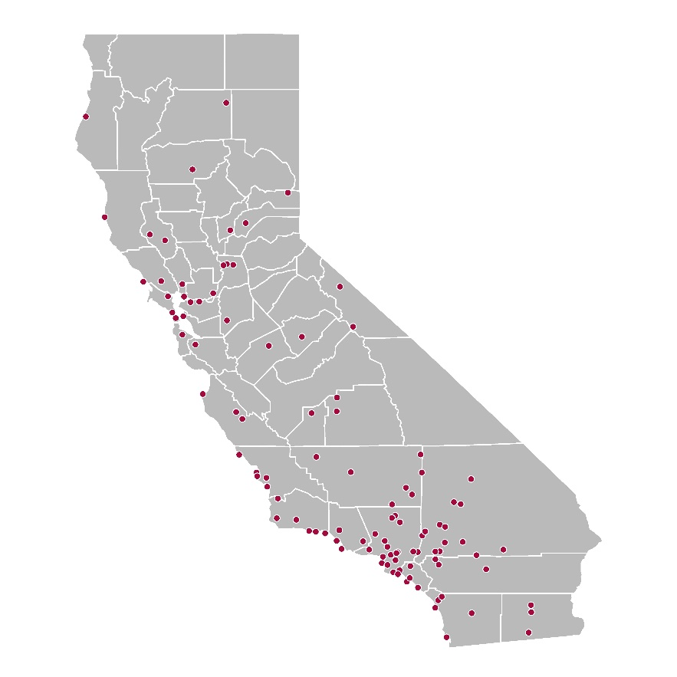
RDN Overview
Financial and economic consulting firm established in 1983
Specialize in smaller cities and districts
Worked with 200+ water/sewer agencies
RDN’s California Experience

Slide 3
Purpose of Study
Ensure sufficient funding for Mendocino City CSD
Ensure Proposition 218 Compliance
Develop utility rates that are equitable to all customers
Project the best financial plan to provide long-term stability of the utilities

Slide 4
Current Rates
Wastewater Customers Pay:
$50.60 a month per Equivalent Single-Family Dwelling (ESD).
Groundwater Management Customers Pay:
$10.63 a month per ESD
One ESD is equal to a 1-2 bedroom single-family residence in the District with a theoretical water demand of 200 gallons per day.

Slide 5
Increased costs of operation
Sources: US Bureau of Labor Statistics, Engineering News Record, California Department of Finance, California Department of Transportation

Slide 6
Revenues and Expenses
Notes:
Current Rates are too low

Slide 7
Cash Balances
Produces no reserves
Funds no capital projects
Negative net balance not sustainable
System fails

Slide 8
Additional Considerations
State sewer treatment standards are getting more stringent, and more costly!
There is no current capital funding plan in place, these costs are also increasing, even as the plant gets older (around $440,000 a year is needed based on estimates of total fixed assets and age of system)
In order to borrow, revenues must cover debt service ratios
Groundwater management costs increase with drought conditions (currently in drought)
Legal expenses continue to increase for groundwater management
Reserves are needed to ensure that future capital funding needs are met as well as potential operating emergencies

Slide 9
Revenue Adjustments
Funds Operations
Contributes to CIP Reserve ($265,000 a year)
Contributes to O&M Reserve ($79,000 a year)
Funds Operations
Contributes to O&M Reserve ($13,000 a year)

Slide 10
Proposed Rates

Slide 11
Final Thoughts
According to Proposition 218, the District cannot make a profit, revenues must equal expenses, including reserves.
If additional funding becomes available or costs do not increase as projected, the Board can choose to not raise rates any year.
Deferring maintenance and revenue adjustments just means that you will have to pay more later to make up the difference.
The Drought doesn’t appear to be going away any time soon.
The current wastewater treatment plant is in dire need of repairs.

Slide 12
Thank You

