Slide 1
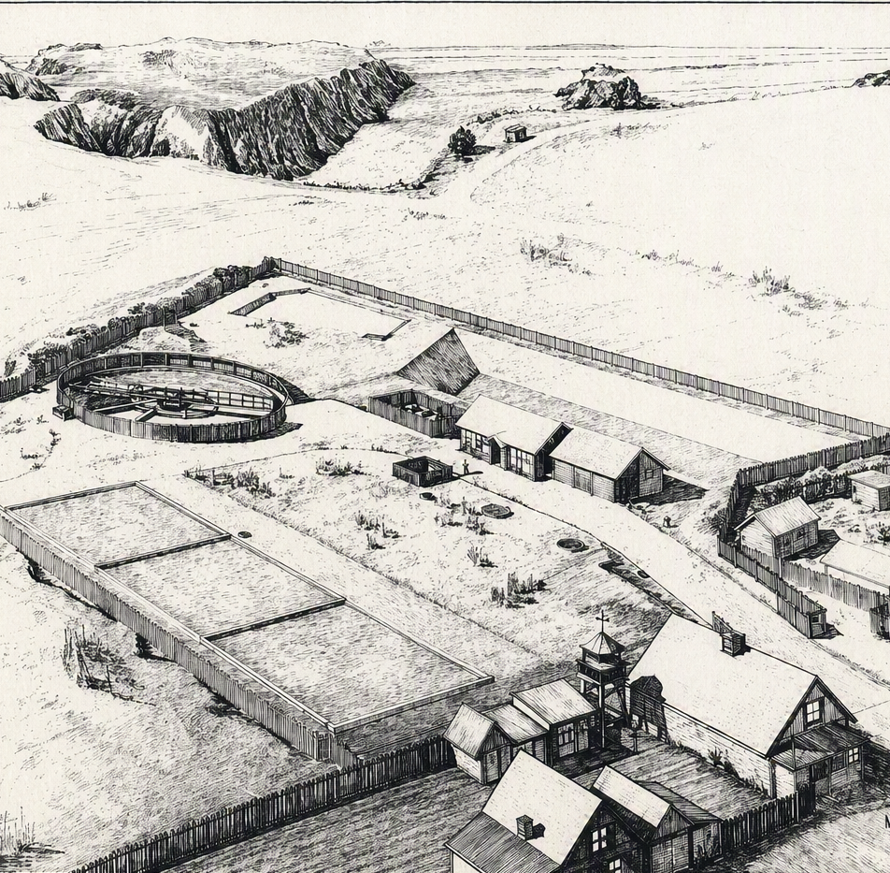

Mendocino, CA
Design Criteria, Alternative Layouts and Preliminary Costs
October 19th, 2026

Slide 2
AGENDA
01
COST ESTIMATING UPDATES
02
EFFLUENT QUALITY UPDATE
03
NON-MONETARY EVALUATION CRITERIA UPDATE
04
NEXT STEPS

Slide 3
Cost Estimating Updates
01

Slide 4
O&M cost breakdown
O&M Items |  | Alt. 0 No Action* | Alt. 1 Rehab and Operational Continuity ​​ | Alt. 2 Rehab and Optimized Modern Configuration​ | Alt. 3 Rehab and High-Quality Effluent
Utilities | Energy | +0 | +0 | -$10,000 | +$59,000
New Expenses | Chemical Cost - MBR cleaning | $ - | $ - | $ - | $ +2,000
 | WWTP spare parts/ short lived assets | +0 | +$45,000 | +$77,000 | +$19,000
Net Annual O&M Increase |  | $ 0 | $ 45,000 | $ 67,000 | $ 80,000
* Replacement of critical components in 2034). Costs in 2026 US$

Slide 5
Alternatives Capital Costs

Slide 6
Effluent Quality Update
02

Slide 7
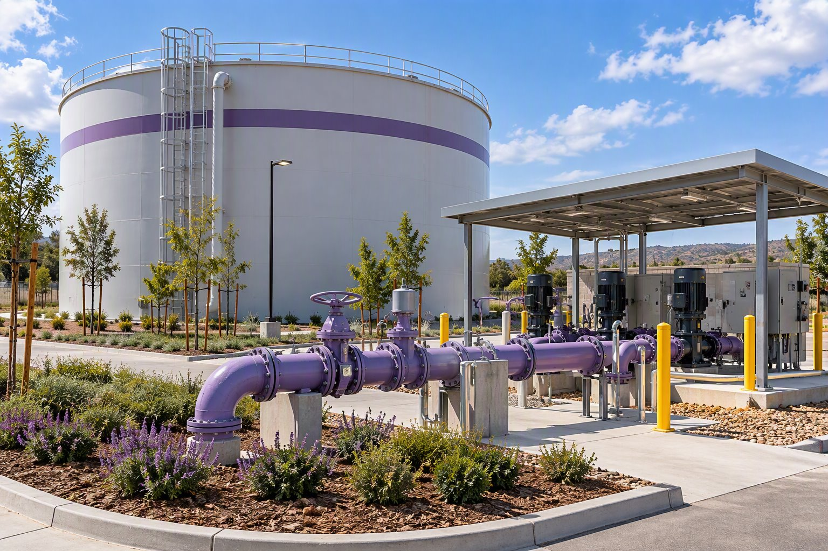
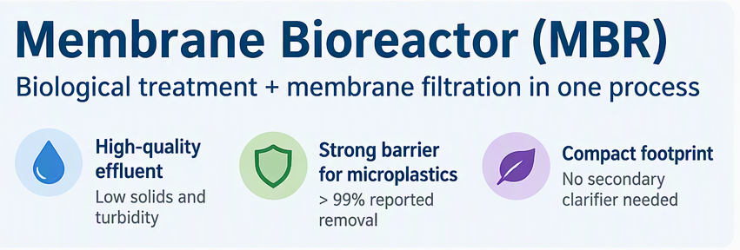
Supporting Current Water Recycle Program
All alternatives are compatible with MCCSD’s expanded non-potable recycled water program.
All three alternatives preserve a reuse pathway
MBR (Alternative 3) provides the highest quality effluent.
  The membrane provides a physical solids barrier.
  Has consistently low-turbidity effluent.

Slide 8
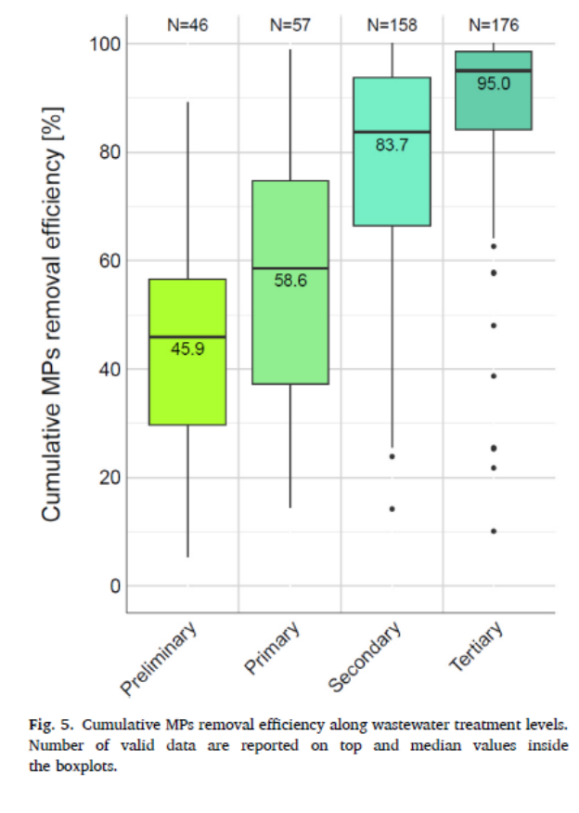
Microplastic Removal potential:
Alternative 1
Alternative 2
Alternative 3
Two Concentric BNR Trains
BNR + Concentric BNR
MBR + Concentric BNR
92–94%*
92–94%*
92-99%*
BNR + clarifier + tertiary filtration
Both trains include tertiary filtration
Parallel MBR and filtered BNR trains
MBR provides a physical membrane barrier and can achieve >99% microplastic removal for MPs ≥ 0.1 mm.
All alternatives provide strong microplastic removal potential; MBR provides the strongest physical barrier for microplastic retention.
Actual removal varies with particle size, treatment configuration, operating conditions, and analytical methods.
* Estimated performance based on reported performances from the literature. Results will differ from case to case.
Source: Navigating microplastics in wastewater treatment: understanding analysis, mitigation, removal strategies, impact, and current knowledge gaps. Journal of Environmental Chemical Engineering 12.6 (2024): 114792.

Slide 9
Non-Monetary Evaluation Criteria
03

Slide 10
Non-Monetary Evaluation Criteria
Alternatives are ranked on each criterion from 1 (worst) to 5 (best), as shown in the table.
Rankings are weighted and summed to calculate a total weighted score.
The highest total weighted score is the most favorable.
Criteria | Weight | Alternative 1 (Concentric Plant) | Alternative 2 (Modern Plant) | Alternative 3 (MBR Plant)
Footprint | 20% | 2 | 3 | 5
Robustness | 20% | 3 | 3 | 5
Constructability | 10% | 2 | 5 | 3
Longevity | 20% | 4 | 4 | 3
O&M Complexity | 20% | 5 | 4 | 2
Effluent Quality | 10% | 3 | 3 | 5
TOTAL WEIGHTED SCORE |  | 3.40 | 3.70 | 3.80

Slide 11
Next Steps
04

Slide 12
Thank you!
Next Steps
Oct 30 - Proposed Alternative and Recommendations (Section 6 and 7)
Nov 27 - Draft PER submittal
Dec 21 - Final PER
Anna Malakian
Sam Reifsnyder
Bernardo Castro
Allie McCurdy

